Slide 1

Doing Good is Good for Everyone
Notes:
Abby, thank you for the introduction and I am pleased to be here today to discuss the benefits of volunteering and how doing good is good for everyone

Slide 2
Agenda
  Employee Volunteer Engagement Programs
    Employee Benefits
    Company Goals and Benefits
    Community Benefits
  What Does it Take?
    Steps to Create an Employee Volunteer
    Engagement Program
  How It’s Done
  Resources
  Discussion and Questions
Notes:
As you can see by our agenda, today we are going to look at Employee Volunteer Engagement programs and how these programs have benefits for the employee – these benefits can be to health and wellness related but also have other benefits for employees, we’ll look at company benefits of employee engagement, including benefits related to corporate social responsibility goals and also look briefly at benefits to the community.
Finish agenda
Before we get started, how many companies currently engage employees in volunteering. (show of hands) Later on I’d like to share examples from one or two of you.
How many have considered engaging employees in volunteering but not gotten started yet?
I hope that today, we will provide the information and resources needed to assist you in taking that next step to engaging your employees as volunteers.

Slide 3
Employee Volunteer Engagement
Programs
Notes:
Employee Volunteer Engagement is a hot topic today. But the idea of corporate citizenship, or of a company actively participating in their community to make the community better has been around in the US since the early 1950’s. In the last two decades, however, a growing number of business leaders have come to view corporate citizenship or employee volunteer engagement, not only as a way to improve their overall community but also as a key business strategy. Companies today often have strategic goals, mission statements, and/or corporate social responsibility goals for their company and employee volunteer engagement programs play a key role in reaching these goals and also providing benefits to their employees.
To get started, let’s look at health and wellness benefits for employees who volunteer.

Slide 4
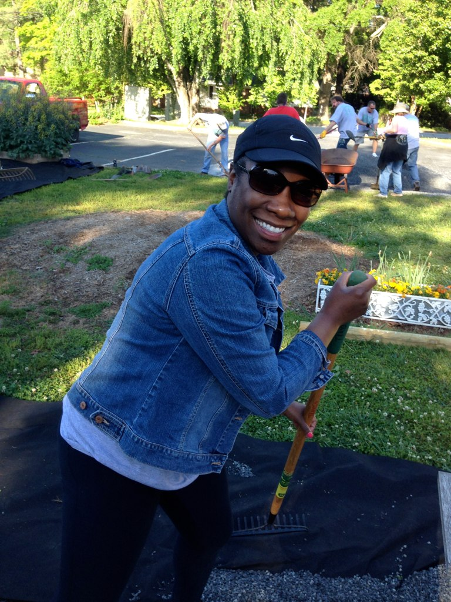
Improved Physical, Mental and Emotional Health
Notes:
Good health – can’t put a price on it. Its important to everyone.
wearable device - measures their health in various ways-we can get caught up in measuring our health by the numbers – either the Number of steps a day, calories burned, etc If we only focus on the numbers– height, weight, blood pressure, cholesterol, we’re missing an overall focus on integrated health or a comprehensive approach to health. – this includes our physical health, but also means experiencing a sense of purpose in life, connecting to individuals, connecting to the community and having an overall good quality of life. How is volunteering involved?
The statistics for the next few slides come from a study conducted by the United Health group, on the benefits of volunteering, they surveyed 3, 351 adults who had volunteered in the previous 12 months prior to the survey.
According to the United Health Group study, volunteering can improve physical, mental and emotional health – that is a powerful statement and has a powerful impact on health. What did the respondents say?
76% of those who had volunteered in the prior 12 months, reported that volunteering made them feel healthier. Those who volunteered, as opposed to those who had not, also were more likely to say that their health had improved in the twelve months that they had volunteered. (not only feeling better, but actual improved health)
A stronger connection to mental health was demonstrated as volunteers, again as opposed to non volunteers, scored better on nine measures of emotional well being. These measures include personal independence, capacity to enjoy rich relationships, and overall satisfaction with life. Volunteers also reported improved mood and self – esteem. Overall the group said that they felt better physically, mentally and emotionally. All important aspects of good health.

Slide 5
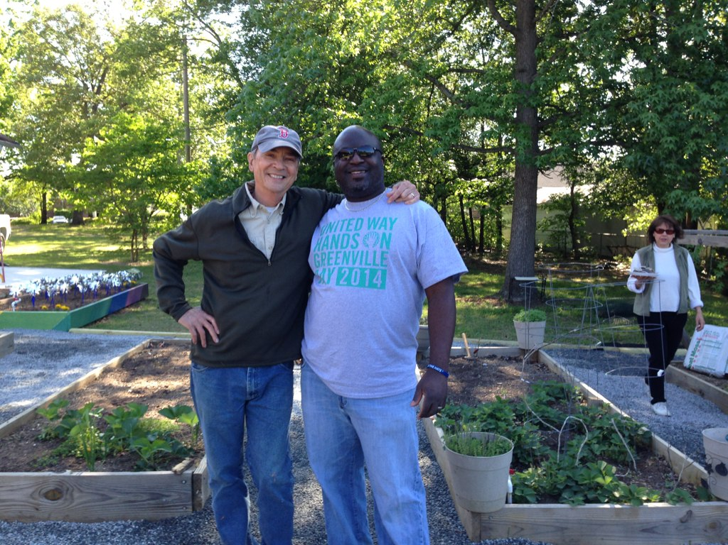
Reduces Stress
Notes:
We all know that too much stress takes its toll in several ways, physically, mentally, emotionally and behaviorally and a second way that volunteering can have a positive impact on our health is by helping to reduce stress. Of the individuals surveyed, 78% reported that volunteering had lowered their stress. Additionally, volunteers in the US overall report that they feel calm and peaceful most of the time, and that they have a lot of energy.
Reducing stress has a positive effect on health and volunteering can play a role in reducing stress.

Slide 6
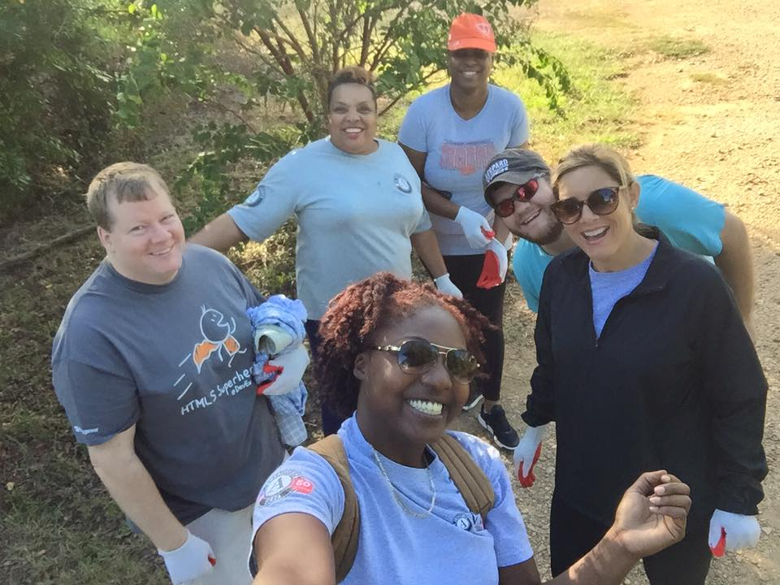
Connections to Others and the Community
Notes:
Also a core component of good health is having and experiencing a sense of purpose and meaning. Almost everyone surveyed who volunteered said that volunteering enriched their sense of purpose, that they believed that they were making their community better and that volunteering helped them learn valuable things not only about the community but also about the world. Volunteering helps people connect to one another and those who volunteer also socialize more and report having developed new friendships through volunteering.
Volunteers derive a sense of satisfaction from assisting others in need and derive a sense of purpose from volunteering, which helps create an overall sense of wellbeing and overall good health.

Slide 7

More Informed Health Care Consumers
Notes:
The employees surveyed who volunteered also reported being more informed as health care consumers. They reported being more engaged and involved in taking care of their own health. 80% of those who had volunteered said that they had more control over their health. Compared to non volunteers, they also considered themselves more knowledgeable about their health and they were more likely to actively seek out information about their health. Volunteers being more engaged health care consumers, can lead to better health care decisions by employees.

Slide 8
Employee Benefits
Time Management Skills
Stronger Colleague Relationships
Communication and Team Building
Professional Job Skills
Notes:
There are other benefits for employees who volunteer. And while these and the health benefits are for the employee, they also benefit the employer.
Improved time management, More than ¾ of people who volunteer said that volunteering helped them with not only with their career and also with their time management.
Often employers often organize days of service for their employees and by doing so it makes it easier for the employees to volunteer, allows employees time to volunteer, and helps the employees to get to know one another outside of work - 64% of employees who volunteer say that volunteering has strengthened their relationships with colleagues.
Workplace today requires collaboration and good communication skills. Often activities involved in volunteering are by nature, collaborative and require good communication. 87% of those surveyed that had volunteered said that volunteering had helped their communication skills and was good as a team building activity.
And last but not least, volunteering utilizes skills that employees have – whether related to finance, marketing or management, Volunteering gives employees not only a chance to use these skills for the greater good, but also gives them opportunity to refine their skills. This is also referred to as skills based volunteering. At UW, we are researching piloting a skills based volunteer program later this year.
Anyone have an example to share of employee benefits from engaging in volunteering?

Slide 9
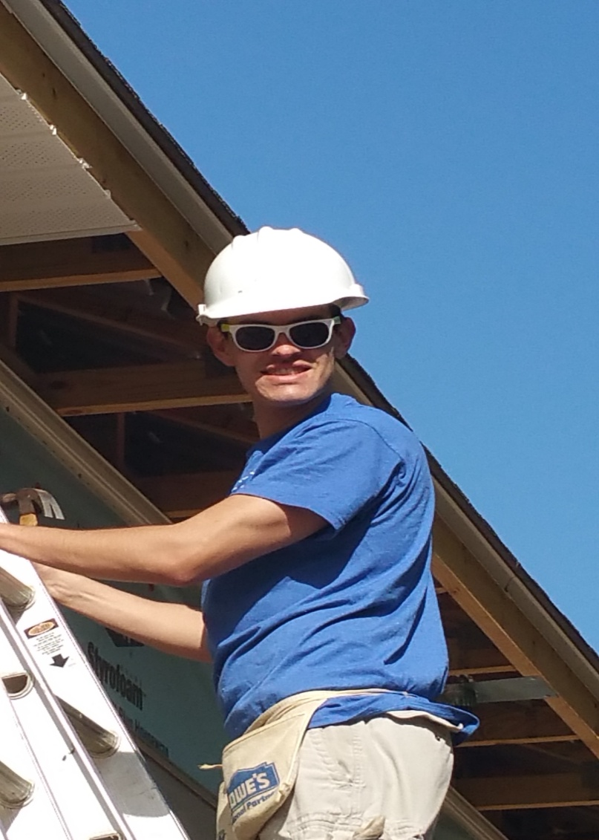
What Companies Want
Employee Engagement is Good Business
Attracts and retains top talent
•Strengthens teams
•Develops strong leadership
•Enhances reputation
•Employees want to make a
difference
Notes:
What do companies want out of employee engagement, why are they willing to engage their employees and what do they say the benefits are?
Companies who engage their employees in volunteering use these opportunities as a way to attract and retain top talent. Examples, showcase community involvement in your lobby, discuss engagement in interview, helps introduce your culture to the prospective and get the right fit and also engage new employees in a volunteer activity in their first days with the company.
They also say that volunteer experiences are great opportunities for team building. Just as the employees say - Some employers also believe that volunteer experiences enhance their employees pride in their company. 4 out of 5 employees who had volunteered with their company said that they feel better about their employer because of the employer’s involvement in volunteer activities.
3) In addition to skill development and team building, employers say that volunteer engagement is a great way to develop strong leadership in their employees.
4) Companies also say that employee engagement enhances their reputation as a good corporate citizen. And, especially today, employers recognize that their employees want the opportunity to make a difference! This is especially true for millennials – in a Points of Light study, 55% of millennials surveyed said the their company’s volunteer policies played into their decision to accept an offer from their company. And 72% of executives surveyed said that corporate volunteering enhances their image as a good corporate citizen
5) more studies are needed to demonstrate the effect of corporate volunteer engagement on the bottom line. However, from a Hands On Network study of corporate volunteering and it’s effect on the bottom line, 82% of executives surveyed said good corporate citizenship helps the bottom line and 52% said corporate citizenship is part of their business strategy corporate citizen.
Examples of company benefits related to employee engagement?

Slide 10
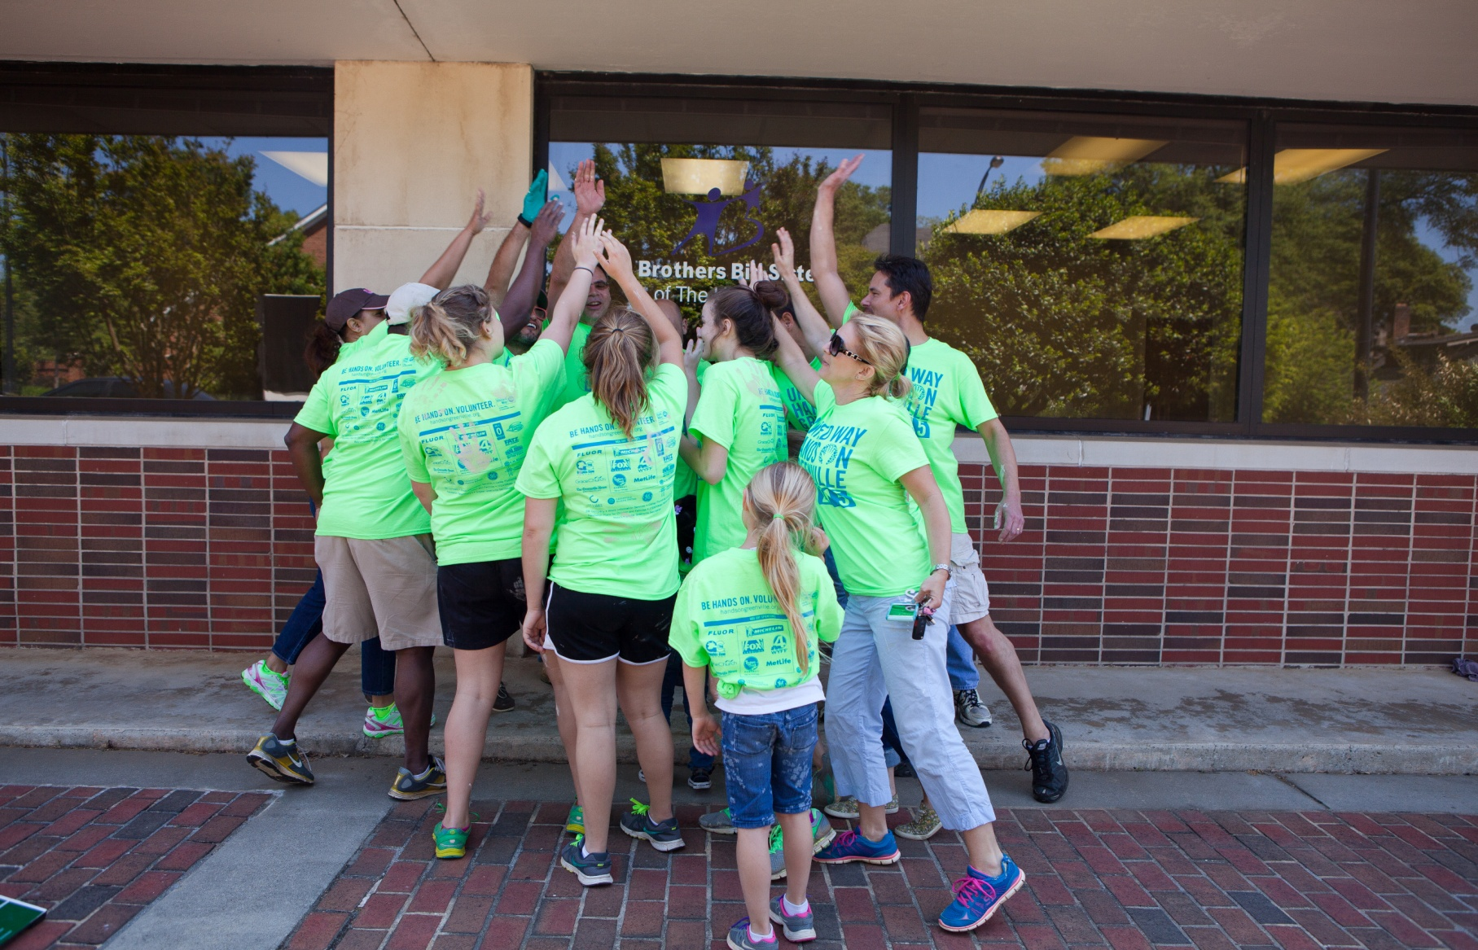
Community Benefits
Notes:
Volunteers serve our community all year round. Through schools, churches, and area non profits. And, since we just had Hands On Greenville Day, this past Saturday, I wanted to share a few of the statistics from this one day of service. It is a huge day of service, but it also is just one example of all that volunteers do for our community year round.
Number of Volunteers 5,000
Number of Projects 160
~ 90 agencies or organizations served, includes agencies, schools, community centers, parks and community clean ups
Number of Hours 20,000, which is an in kind value of over $470,000 given back to the community
In kind
As I mentioned, volunteering goes on all year and does a great deal to strengthen our community and improve their lives of others in our own backyard.
Questions or comments?
Anyone who engages their employees have any benefits to share, whether employee or employer?

Slide 11
What Does it Take?
Secure Top Management Support
Assess Needs & Survey Employees
Identify Business Goals
Develop a Program Structure and Policies
Notes:
Senior management has to be on board, at all levels of management. And for senior managers need to champion the program and participate in volunteer activities – sends an important message (UWGC ex)
Its important to remember that you want to meet company goals but also meet community needs. Its much better to meet a community need rather than to develop a volunteer opportunity that meets your needs first.
Connect with United Way as one source of information about what the community needs are. Also, survey your employees to find out what their interests are. There are surveys already developed for this purpose. They ask what types of volunteering an employee has volunteered for, given money to, what types of activities they like to do, etc.
A successful program reflects the culture and values of a company while adding value to the business objectives. Use your business objectives as your beginning piece to develop your employee volunteer program.
As an example, Michelin has a community relations strategy that support the local economy through job creation, supports personal development of local residents and supports actions that support the quality of life of local residents. (paraphrased)
Encourage participation from all levels of employees and think about setting up an employee steering committee to determine the focus of the program. They will also be champions for the program across your organization. Develop written policies and also be sure to research your liability and accident insurance. Know what’s covered and what is not. You want to know that everyone is protected before you begin to engage in volunteering.

Slide 12
What Does it Take?
Align Volunteering with Financial Support
Measure the Program and Evaluate
Establish a Recognition or Awards Program
Publicize Your Efforts
Notes:
5) Align your volunteering with financial contributions. Consider volunteering where the company also gives. (company values) Dollars and volunteering are more powerful together.
6) Measure the program. And evaluate. Track employee participation and satisfaction. There is software that companies use, but some companies also use spreadsheets to track participation. Our HOG site, is a way to
track individual volunteer participation. Nearly 90 percent of the companies that measure the connection between volunteer participation and employee engagement have found a positive correlation between volunteer participation and engagement scores. (Target uses Volunteer Match to make volunteering accessible and to track hours)
Establish a recognition or awards program. People love incentives and people also enjoy a thank you. Some items can be certificates, t shirts (HOG shirts!) and mugs. Company newsletters are also a great way to say ‘Great job!”
Publicize your efforts – internally and externally. Communicate before and after the event. Results and especially pictures and stories – are especially important to keeping people motivated and sharing the impact of your employee volunteer engagement.

Slide 13
How It’s Done
Company Priority and Goals
Management Support
Community and Engagement Committee
Employee Recognition
Notes:
First, I would like to share a video, featuring Megan Horton, a UPS employee and she is also a Hands on Greenville volunteer and volunteers with United Way and other organizations. She was featured during National
Volunteer Week this year, on our face book page, as a way to demonstrate the value of volunteering including how UPS is involved in volunteering.
1)Volunteering is a priority for UPS and they set a yearly goal of volunteering of 7,000 plus hours for their employees. They align their volunteering to UW priority areas but also listen to their employees for their interests and causes that they support.
2) Management is in support of volunteering – and administrators at each facility approve the hours, they also have an internal and external site for posting opportunities and logging hours
3) Their community and engagement committee is represented by 10% of their employee population and there is a committee member from each department.
Volunteering is offered to all levels of employees - examples, weekly meals on wheels route, quarterly projects with Hands on Greenville – Book Bunny, School Tools, and HOG Day
And team building projects organized during the work day – for 1 -2 hours.
4) they also hold contests for employees, based on the hours they log, employees are eligible for small prizes, but they also feature employees in company communications
SHARE EXAMPLES

Slide 14
Resources
www.handsongreenville.org
http://www.pointsoflight.org
http://ccc.bc.edu
Notes:
HOG
Points of Light
Boston College Center for Corporate Citizenship
Discussion
Questions

Slide 15
Volunteering Makes a Difference!
Notes:
Volunteering really does make a difference! Certainly it makes a difference for our community, but it also makes a difference for those who volunteer, in more than one way. In addition to feeling good about what you accomplish, volunteering also has positive health benefit, serve as team building and leadership opportunities, which benefits the volunteer, and can help companies reach their corporate social responsibility goals.
While volunteering is helping others in our community, it is also helping ourselves, and that means benefits for employees who volunteer and also benefits for their employer.

