Slide 1
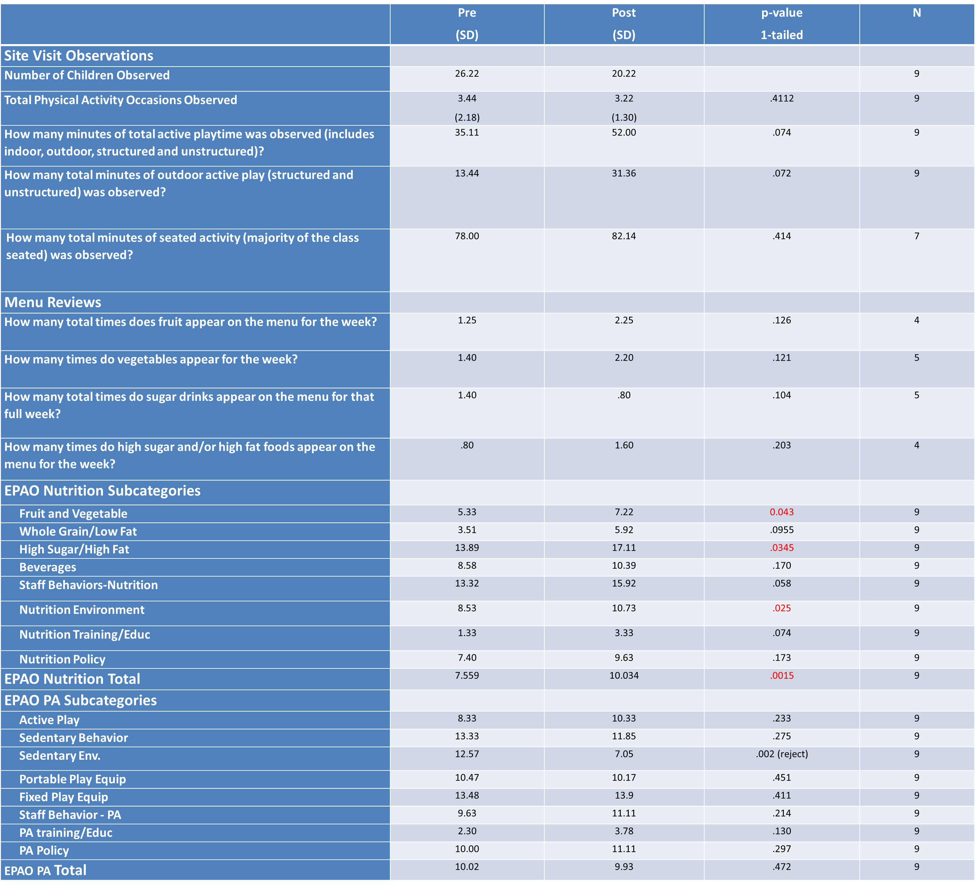
Use of Environment and Policy Assessment Observation (EPAO) tool in Afterschool Settings
to Support Policy and Environment Change
K. Kemper, Clemson University, A. Powers, Furman University, S. Pate, Furman University, R. Shealy, Clemson University, M. Jackman, Furman University, M. Fair, University of South Carolina.
After-school programs are important settings to promote behaviors consistent with healthy body weights among children. LiveWell Greenville (LWG), a broad-based community coalition, launched an initiative to help afterschool programs adopt policies and practices that support youth obesity prevention goals. This study used the EPAO tool to examine the impact of the LWG afterschool initiative on nutrition and physical activity (PA) environments and policies in afterschool programs.
Instrument. The EPAO tool was originally designed as an objective assessment instrument of environmental change to compliment the Nutrition and Physical Activity Self-Assessment in Child Care (NAP SACC) tool. The EPAO is used to systematically document child and staff behaviors, the afterschool environment and nutrition and PA policies. Questions are grouped into a Nutrition Score with 8 nutrition subcategories and a PA Score with 8 PA subcategories.
Intervention (Figure 1). The LWG afterschool community-workgroup developed an intervention to promote nutrition and physical activity best practices (Table 1) presented in the NAP SACC tool (sedentary time; PA time; availability of sugar sweetened beverages (SSB), sweet and salty snacks, fruits and vegetables; staff behaviors and policies supporting nutrition and PA practices). Afterschool staff completed the NAP SACC at baseline and again within 5-8 months after the start of the intervention.
Figure 1. LWG Intervention
Table 1. Priority Best Practices
Table 2. EPAO Observation Means and Paired T-Tests
Methods: A non-experimental, pre-post study was conducted in 20 afterschool programs. Program staff were asked to program materials (snack menu, employee/parent handbooks, written policies regarding nutrition and PA) during the evaluator’s site visit. Data were scored following modified EPAO protocols. Paired t-tests were used to determine if significant changes occurred across the EPAO nutrition and PA practices, sub-categories and total scores.
Results: Baseline EPAO data was collected for 20 sites. Only nine sites had adequate intervention duration to be included in the final analysis (4.5 to 7 months). There was an increase in the number of programs meeting recommendations for PA time and for fruit and vegetable and SSB offerings (Table 1).
Significant increases were observed for 3 nutrition sub-category scores and for the Total Nutrition Score (Table 2). No significant changes were observed for PA measures.
Conclusions. Positive changes in nutrition and PA environments and practices in afterschool settings were observed using the EPAO and provided support for a positive impact of the LWG initiative in this setting. Several constraints were encountered, however, which weakened the studies ability to fully assess the program’s impact.

